Slide 1
Setup

Slide 2
Software
NodeJS and NPM
NodeJS is the platform needed for the ReactJS development.
Run node –v and npm –v to check if software is installed.

Slide 3
Creating React App
Using webpack and babel.
Using the create-react-app command.

Slide 4
Webpack
Webpack is a module bundler (manages and loads independent modules).
It takes dependent modules and compiles them to a single (file) bundle.(combination and minification of JavaScript and CSS files and other assets)
You can use this bundle while developing apps using command line or, by configuring it using webpack.config file.
package.json, which includes everything you need to bundle with webpack
webpack.config.js, which contains the configuration needed for webpack to create the bundles

Slide 5
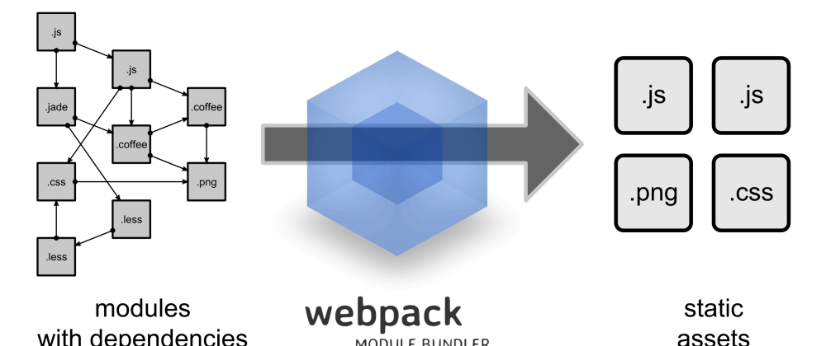
Webpack

Slide 6
Babel
Babel is a JavaScript compiler and transpiler. It is used to convert one source code to other.
React uses JSX syntax. Babel is a transpiler i.e. it converts the JSX to vanilla JavaScript.
React also uses ES6, which is not supported by most of the browsers. Babel converts the ES6 code to a plain old ES5code which can be run on all browsers.
.babelrc, which contains the Babel settings needed to compile JSX files

